Slide 1
Facial Recognition to Detect Mood and Suggest Songs Accordingly
Submitted in the partial fulfillment for the award of the degree of
BACHELOR OF ENGINEERING
IN
Artificial Intelligence and Machine Learning
Submitted by:
Hritvik Mathur 20BCS6760
Devi Prasad Samantaray 20BCS6749
Amisha Khanna 20BCS6712
Under the Supervision of:
Shubhangi Mishra
Department of AIT-CSE
DISCOVER . LEARN . EMPOWER

Slide 2
Outline
Introduction to Project
Problem Formulation
Objectives of the work
Literature survey
Methodology used
Results and Outputs
Conclusion
Future Scope
References

Slide 3

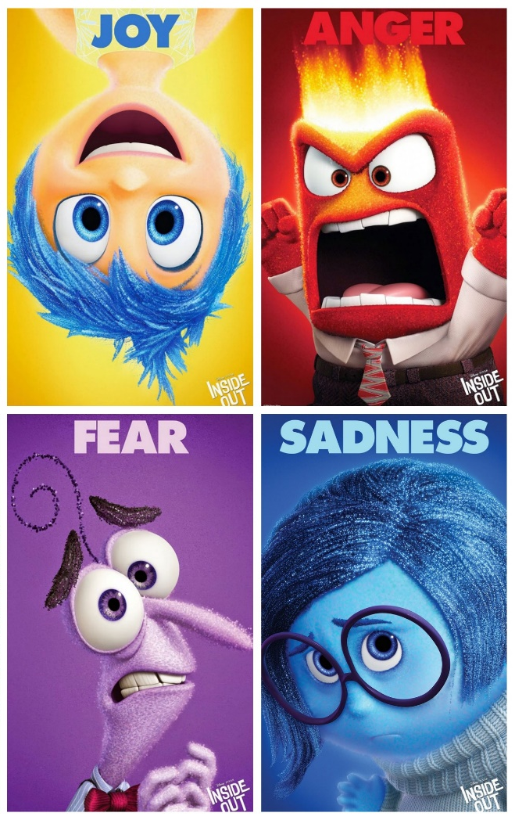
Introduction to Project
In today's digital age, music is an integral part of daily life, offering entertainment, relaxation, and emotional support.
However, the challenge lies in selecting the right music that matches an individual's current mood and emotional state.
This project seeks to address this issue by developing a system that employs facial recognition technology to accurately detect a user's mood and suggest songs that resonate with their emotions.

Slide 4


Introduction to Project
This project aims to leverage facial recognition to detect the user's mood and suggest music that aligns with their emotional state, thereby enhancing the music listening experience.
The primary goal of this project is to address this issue by developing a groundbreaking system that utilizes facial recognition technology to detect a user's mood in real-time and suggest songs that harmonize with their emotional context. This system, at its core, aims to enhance the user's music listening experience by providing personalized and emotionally resonant recommendations.

Slide 5

Problem Formulation
The central problem at hand involves developing a sophisticated system that can seamlessly blend facial recognition technology with music recommendation to enhance the user's music listening experience. This system must accurately detect the user's mood through facial expressions, classify these emotions effectively, and offer song recommendations that align with the user's emotional state at that very moment.

Slide 6
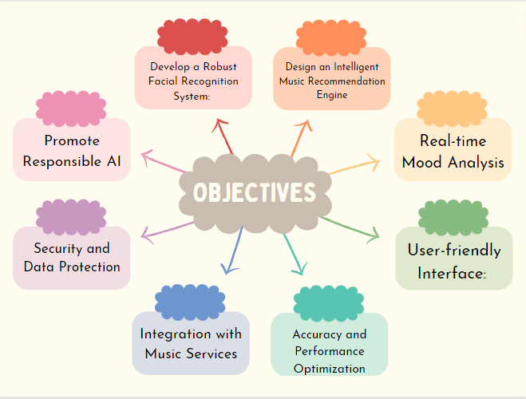
Objectives of the Work
Project objective is to create a single program that can replace and effectively combine all the listed features :
Facial Recognition System
Emotion Classification
Music Recommendation Engine
Ethical Considerations

Slide 7
Literature Review
Year and Citation | Article/ Author | Tools/ Software | Technique | Source | Evaluation Parameter
2023 | Facial Emotion Recognition and Music Recommendation System Based on Facial Expression Analysis | Deep Learning | CNN | IEEE | Accuracy is 73.02%
2021 | Music Recommendation Based on Face Emotion Recognition" | Python Deep Learning | CNN | https://shorturl.at/BCIVZ | Accuracy of 80%
2020 | Smith, J. et al. | OpenCV, TensorFlow | Deep Learning (CNN) | IEEE | Accuracy, Precision, Recall, F1-score, User Satisfaction

Slide 8
Literature Review
Year and Citation | Article/ Author | Tools/ Software | Technique | Source | Evaluation Parameter
2023 | Facial Emotion Recognition and Music Recommendation System Based on Facial Expression Analysis | Deep Learning | CNN | IEEE | Accuracy is 73.02%
2021 | Music Recommendation Based on Face Emotion Recognition" | Python Deep Learning | CNN | https://shorturl.at/BCIVZ | Accuracy of 80%
2020 | Smith, J. et al. | OpenCV, TensorFlow | Deep Learning (CNN) | IEEE | Accuracy, Precision, Recall, F1-score, User Satisfaction

Slide 9
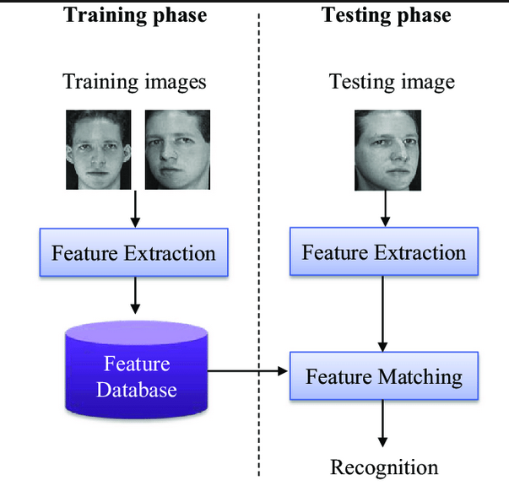

Feature/characteristics Identification
In this initial phase, you identify and list down all the features, characteristics, and requirements that your system or product should have. These can be both functional (what it does) and non-functional (how it performs) requirements.
For the "Facial Recognition to Detect Mood and Suggest Songs" system, this could include features like real-time mood detection, music recommendation, user feedback, privacy controls, and integration with different platforms.

Slide 10
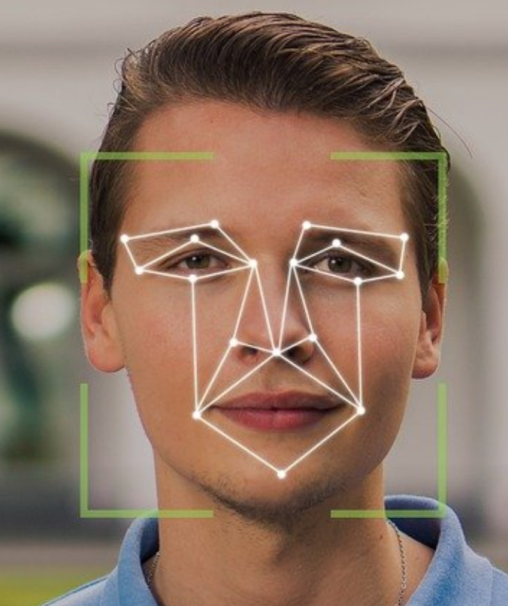
Constraint Identification
Constraints are limitations or restrictions that may affect the design and implementation of your system. These constraints can be technical, budgetary, legal, or related to user preferences.
For your system, constraints might include limitations in facial recognition accuracy, budget restrictions for implementing the technology, legal constraints related to privacy and data protection laws, and user preferences regarding the level of control they want over the system.

Slide 11
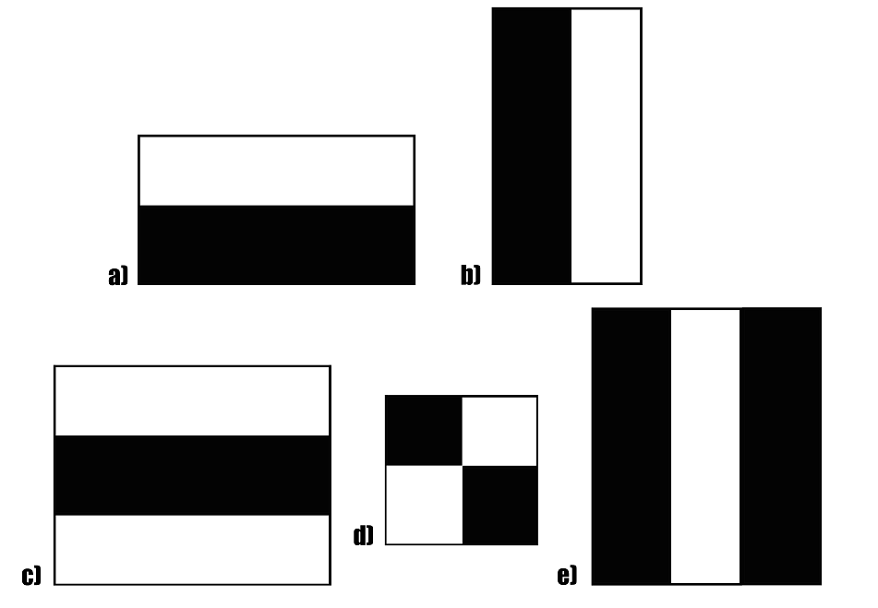
Haarcascade
Haar cascade is an algorithm that can detect objects in images, irrespective of their scale in image and location.
This algorithm is not so complex and can run in real-time. We can train a haar-cascade detector to detect various objects like cars, bikes, buildings, fruits, etc.
Haar cascade uses the cascading window, and it tries to compute features in every window and classify whether it could be an object.

Slide 12

Analysis of Features and finalization subject to constraints
In this phase, you analyze the identified features and characteristics in the context of the constraints. You may need to prioritize features based on their importance and feasibility within the given constraints.
For example, you might decide to prioritize accuracy in mood detection while working within a budget constraint for implementing the facial recognition technology. You'll need to ensure that the system respects privacy constraints and legal requirements related to data handling.

Slide 13
Design selection
Once you've analyzed the features and constraints, you can proceed to select a design or approach that best meets the requirements and addresses the identified constraints.
In the case of the mood-based music recommendation system, this could involve selecting the specific algorithms and technologies for facial recognition, mood classification, and music recommendation. It may also involve deciding on the user interface and user experience design.

Slide 14
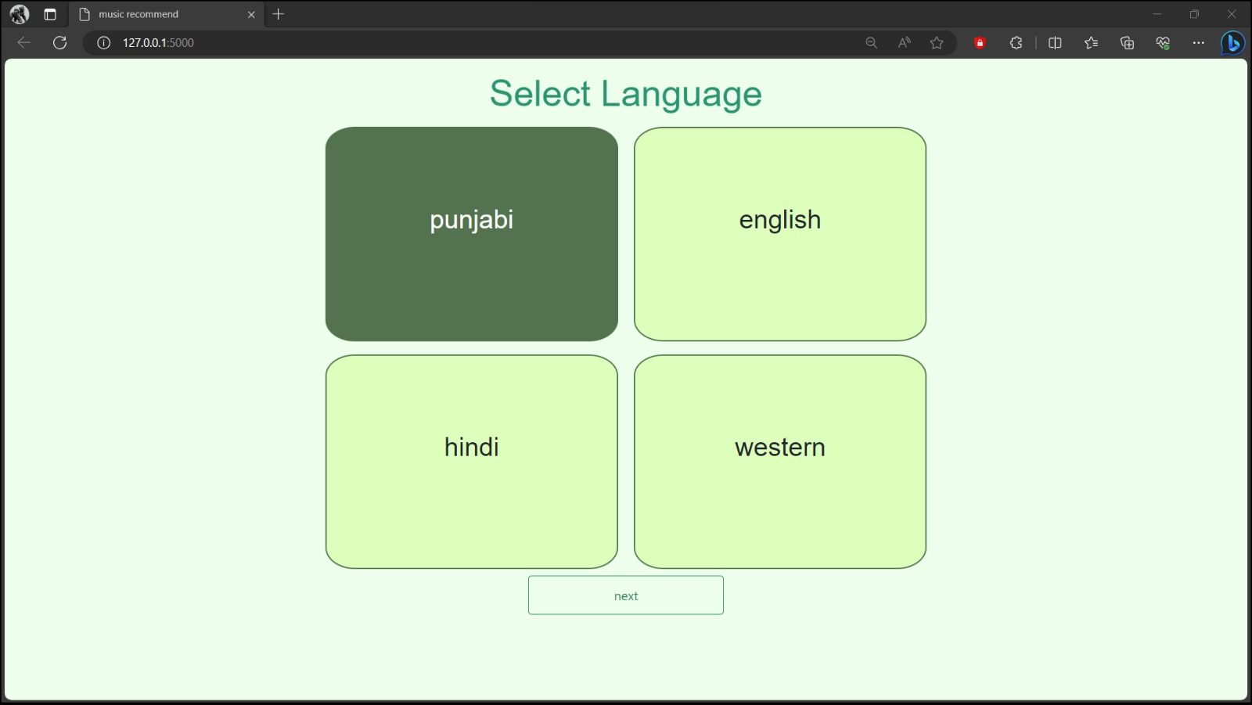
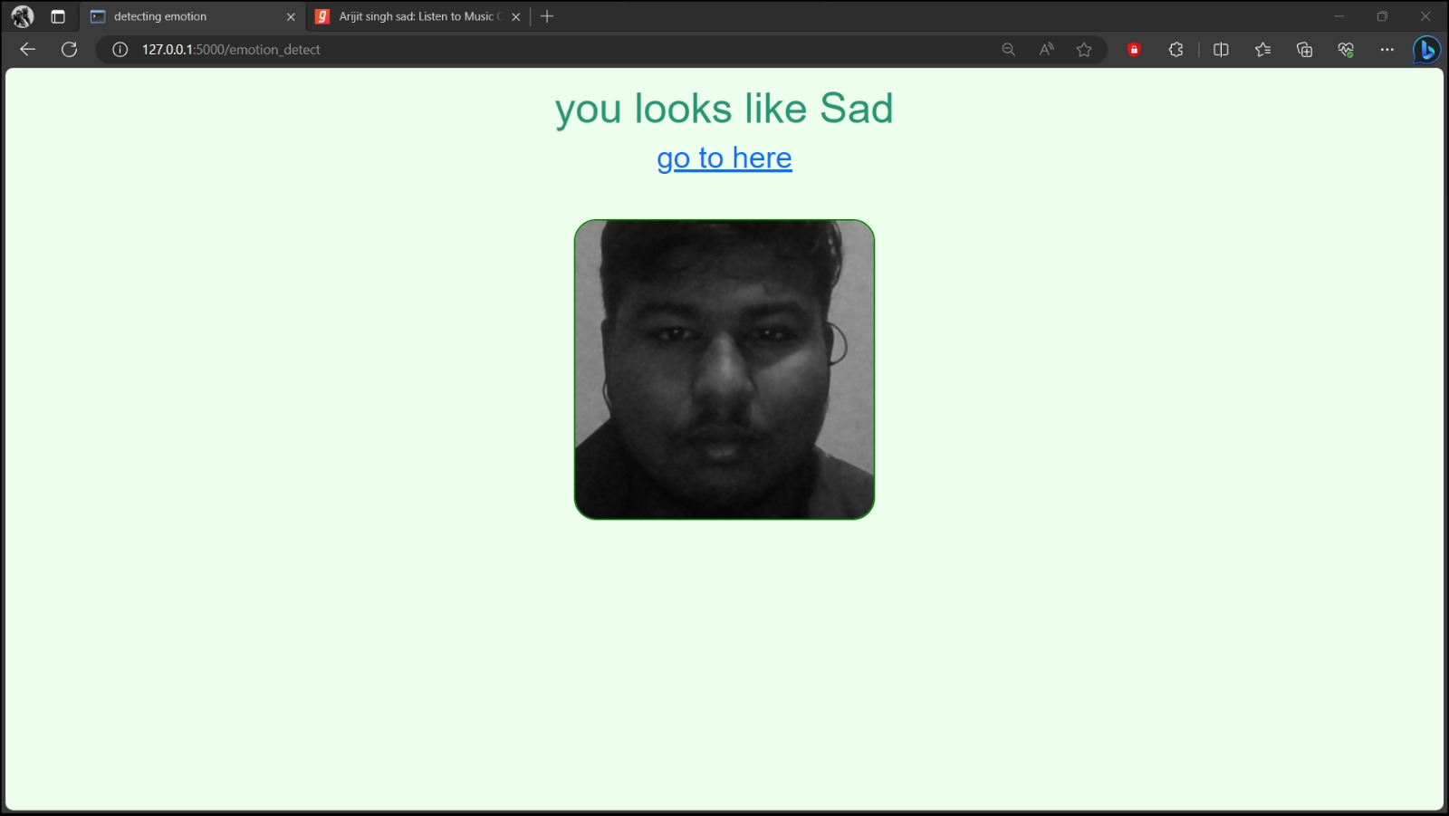
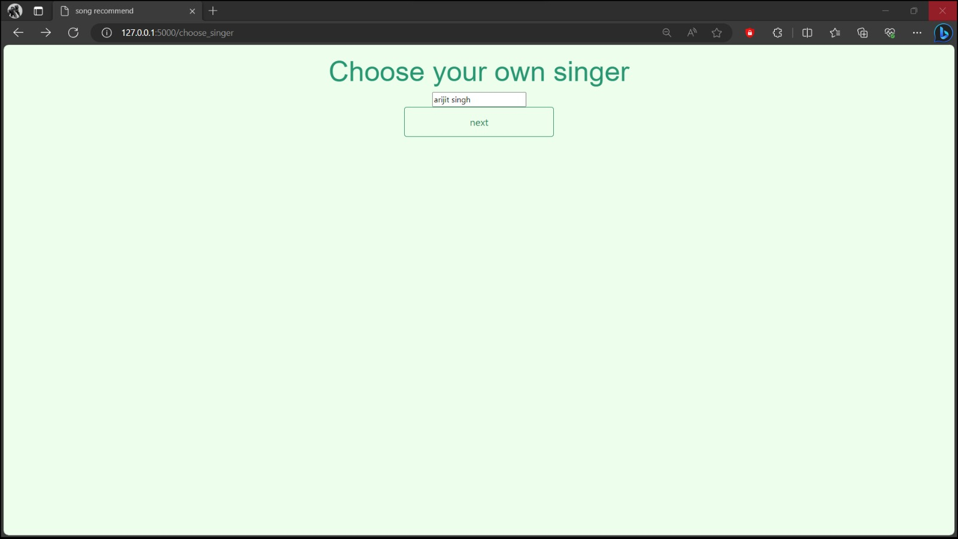
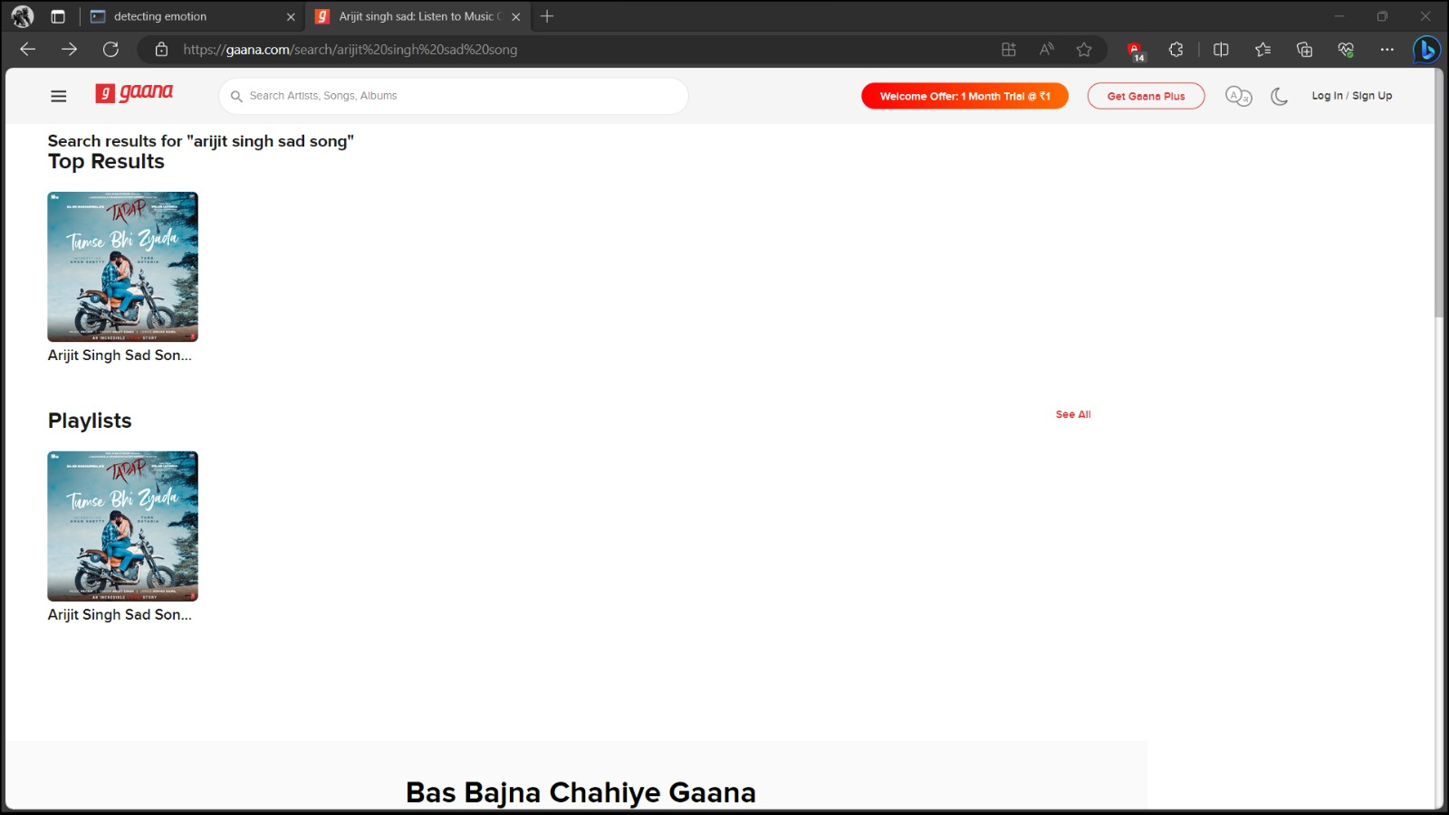
Prilimanary design

Slide 15
Methodology Used
1. Initialization and Setup: Import required libraries and create a Flask web app instance. Configure the app and initialize variables for user information, emotion labels, and a pre-trained Keras model for emotion recognition.
2. Route Definitions:
/: Renders the landing page for users.
/choose_singer: Captures language selection and renders a page for choosing a singer.
/emotion_detect: Captures webcam video, detects faces, predicts emotions from the detected faces, and opens a YouTube search link based on the predicted emotion, singer, and language.
3. User Interaction: Users start on the landing page, choose a language, select a singer, and initiate emotion detection. The app captures their webcam feed, predicts their emotion, and suggests music on YouTube based on their emotions and musical preferences.

Slide 16
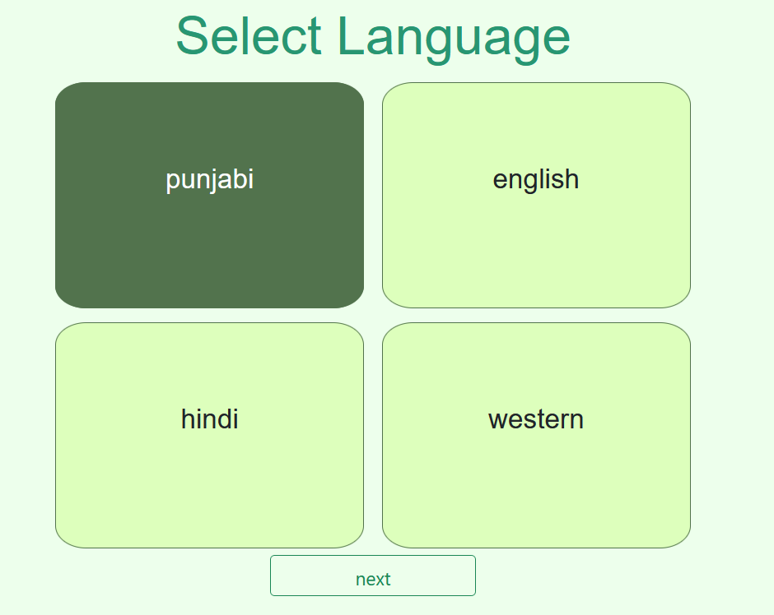
Results and Outputs

Slide 17
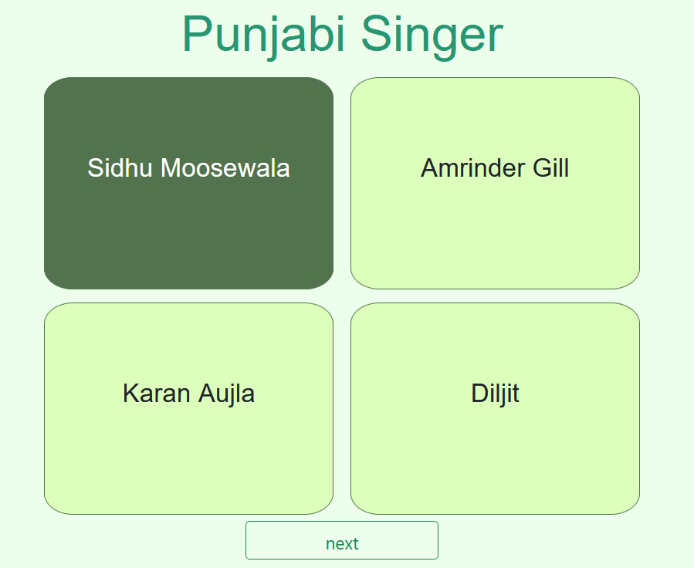
Results and Outputs

Slide 18
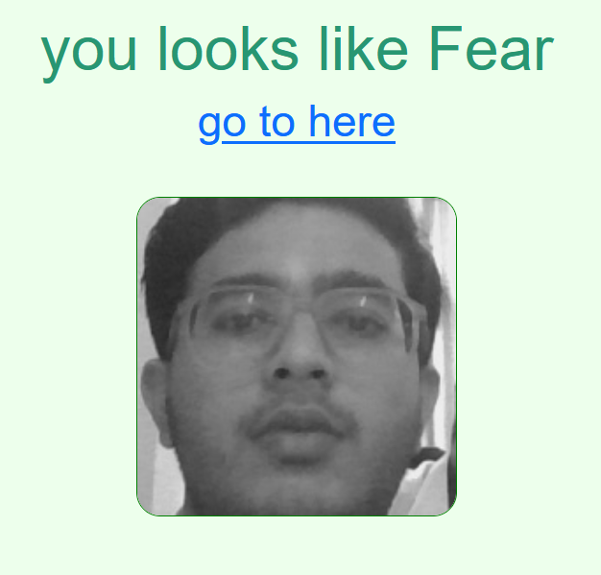
Results and Outputs

Slide 19
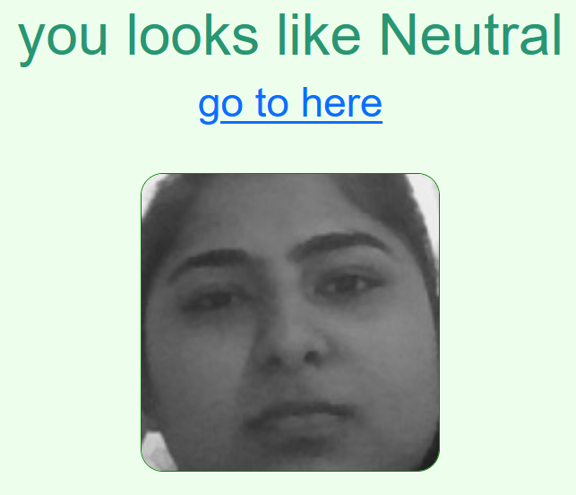
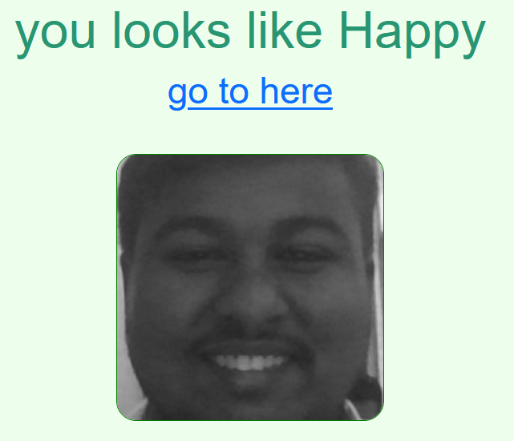
Results and Outputs

Slide 20
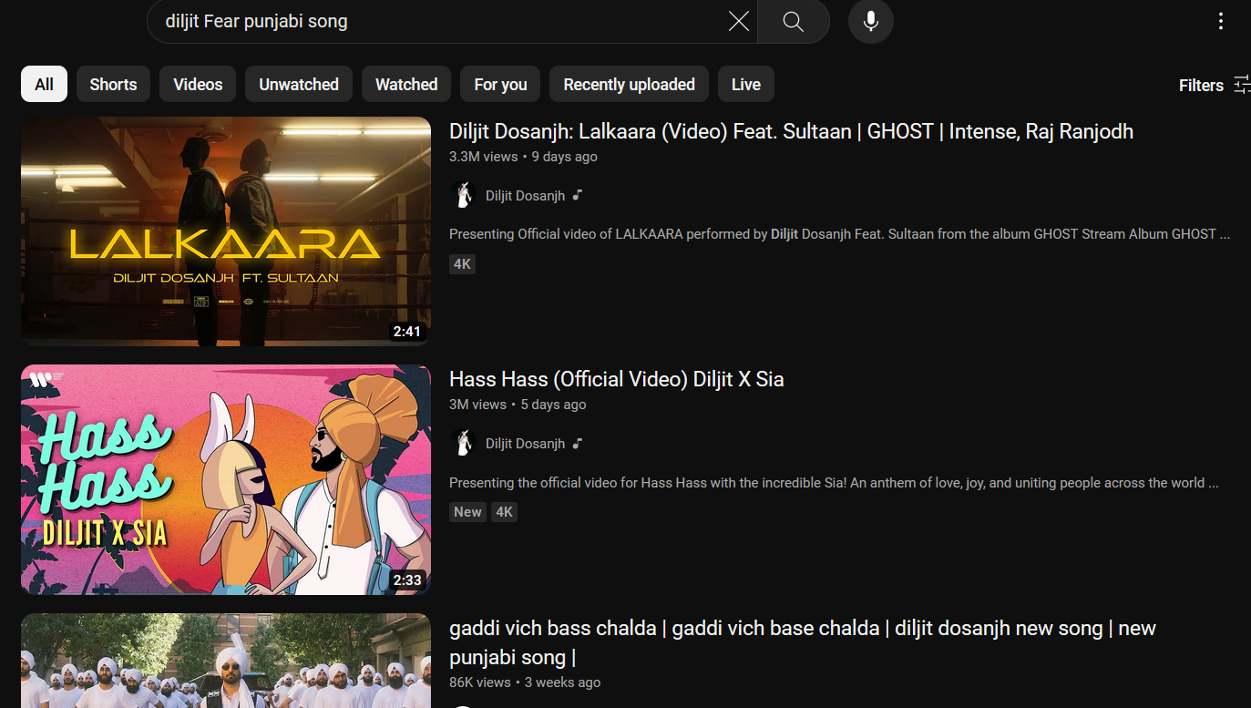
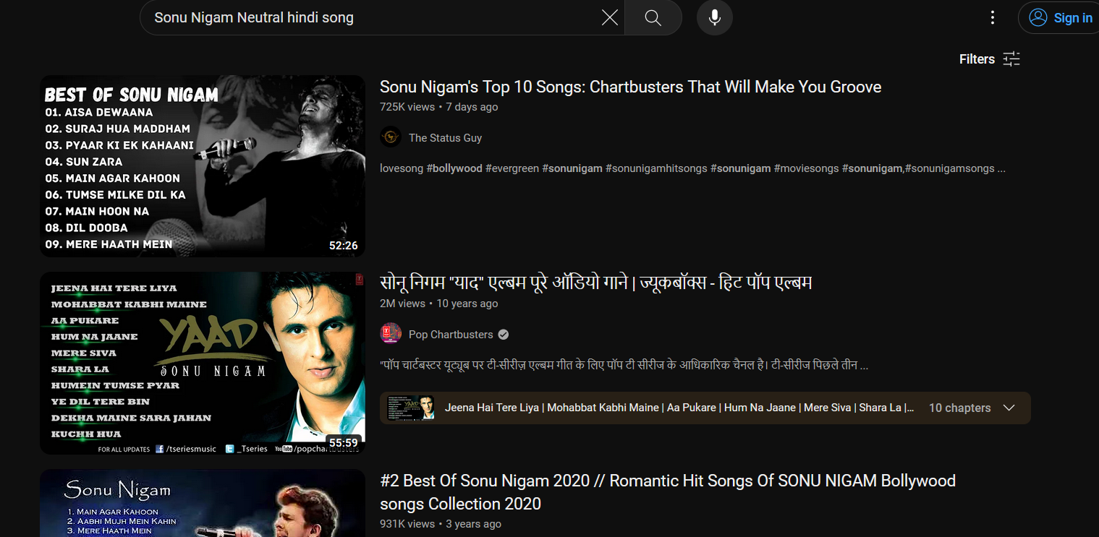
Results and Outputs

Slide 21
Conclusion
In conclusion, the "Facial Recognition To Detect Mood And Suggest Songs Accordingly" project represents an exciting and innovative endeavor at the crossroads of technology, emotion analysis, and music recommendation. This project aspires to provide a unique and highly personalized music listening experience by leveraging facial recognition technology to detect the user's current emotional state and recommend songs accordingly

Slide 22
Future Scope
Train a larger and more diverse model. The model used in this project was trained on a relatively small dataset of facial expressions. Training a larger and more diverse model could improve the accuracy of the system.
Explore the use of other facial features. In addition to the facial features used in this project (e.g., eyebrows, eyes, mouth), other facial features, such as eye gaze and head pose, could also be used to improve the accuracy of mood detection.
Develop a mental health monitoring system. A mental health professional could use a mood detection system to monitor the mental health of their patients and identify those who may be at risk of developing mental health problems.

Slide 23
References
[1] Liu, M., Wang, X., & Li, J. (2019). Emotion recognition in conversation using a sequence-to-sequence model with long short-term memory. IEEE Access, 7, 28984-28992.
[2] Jang, J. S., & An, W. (2017). Facial expression recognition using CNN: A survey. Sensors, 17(7), 1473.
[3]Pampalk, E. (2006). Auralization of music style. IEEE Transactions on Multimedia, 8(2), 281-290.
[4] Tzanetakis, G., & Cook, P. (2002). Musical genre classification of audio signals. IEEE Transactions on Speech and Audio Processing, 10(5), 293-302.

